Slide 1

Safety Beacon Team: NEUROSOFTWARE
Nathan Tannar (ntannar@sfu.ca)
Jason Tsang (jrtsang@sfu.ca)
Philip Leblanc (paleblan@sfu.ca)
Josh Shercliffe (jshercli@sfu.ca)
Youjung Kim (youjungk@sfu.ca)
Website: https://github.com/nathantannar4/Safety-Beacon
Presentation Date: December 4th, 2017
Notes:
15 sec

Slide 2
Overview
The Problem and Target Audience
Safety Beacon Introduction
Summary and Feature Overview
Basic Architecture
Software Testing and Quality Assurance
User Feedback
Features Not Fully Implemented
Post-Mortem
Video Demo
Notes:
15 sec - Jason

Slide 3

The Problem
6 out of 10 patients with Alzheimer’s will wonder off and get lost![1]
Target Audience
Alzheimer’s patients in their early to mid stages
Patients in the habit of always carrying their phone on person
Patients that primarily get around by foot
Family members or healthcare professionals (Caretakers) concerned about their whereabouts
[1] | A. Association, "Alzheimer's Association," 2017. [Online]. Available: http://www.alz.org/care/alzheimers-dementia-wandering.asp.
Notes:
30 sec - Jason

Slide 4
Introducing: Safety Beacon
TL;DR
A tracking application that enhances walking navigation for the Patient, and provides analytics and notifications for the Caretaker.
Notes:
20 sec - Jason

Slide 5
1 App – 2 Different Users
Notes:
10 sec - Jason

Slide 6
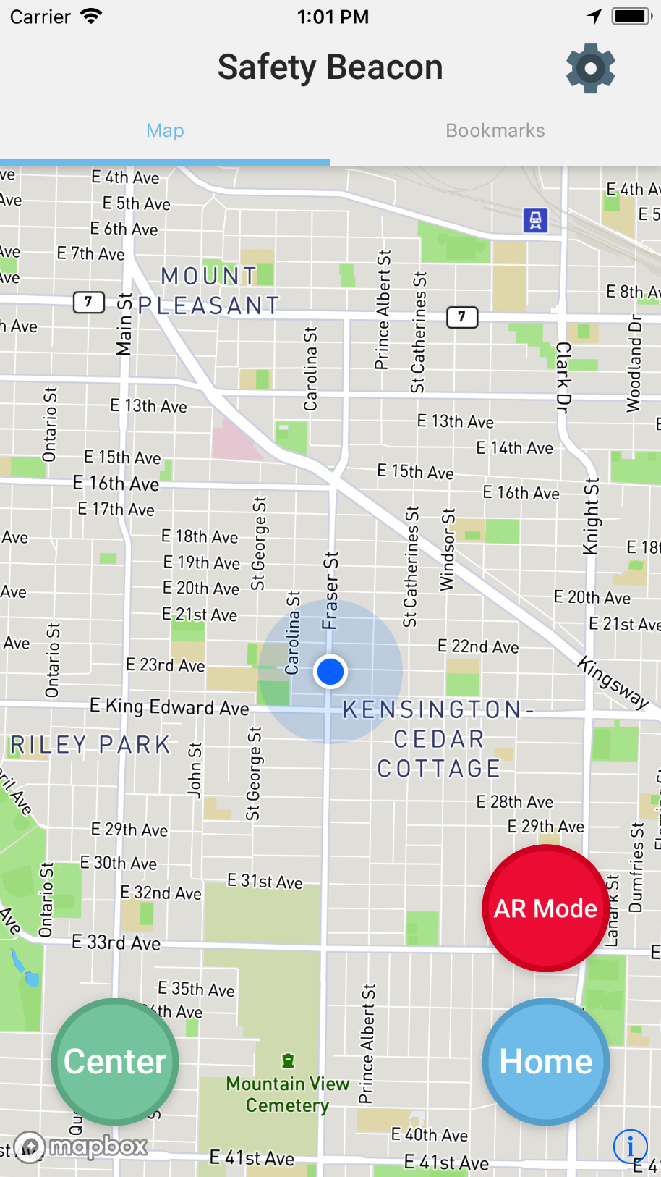
Patient
Highlights:
“Home” button that instantly starts standard map navigation directions home
“AR Mode” button that instantly starts Augmented Reality navigation home
A pre-set Bookmark table by the Caretaker for quick standard or AR Mode navigation
Notes:
30 sec - Youjung

Slide 7
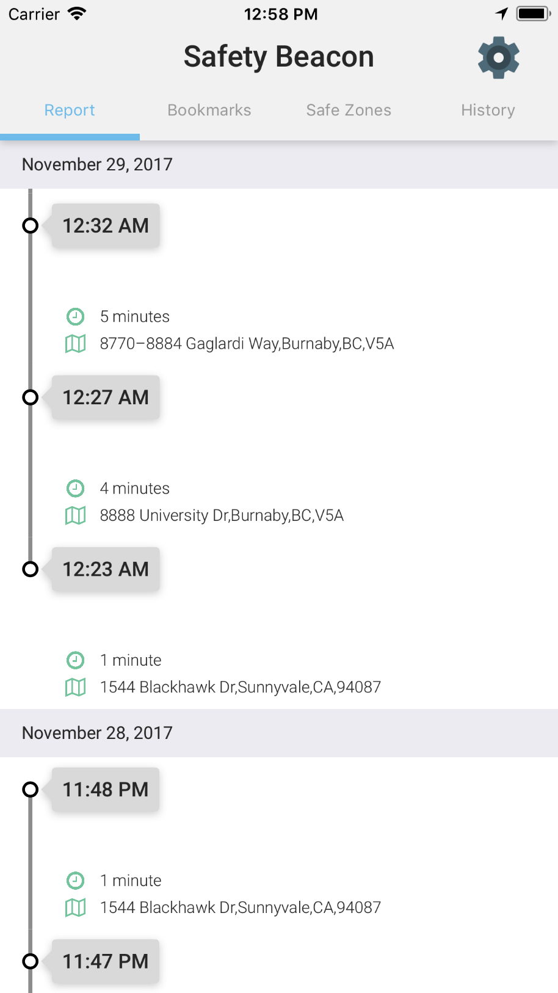
Caretaker
Highlights:
Report of recent and previous whereabouts
Setup Safe Zones locations and radius size
Get notifications when the patient exits or enters these regions
Setup Bookmark locations
View filtered history map plot of patients previous whereabouts
Notes:
30 sec - Josh

Slide 8
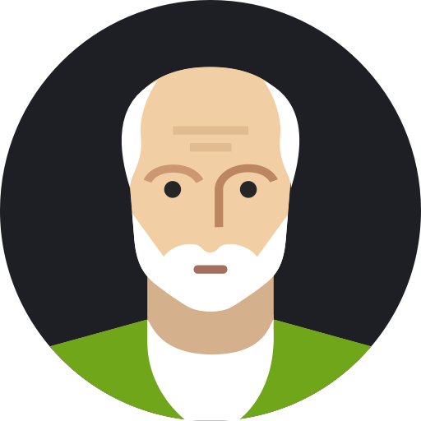

Basic Architecture
Server
Safety Beacon (Patient)
Safety Beacon (Caretaker)
Gyroscope
GPS
AR
Notifications
Reports and History
Notes:
30 sec - Nathan

Slide 9
Software Testing and Quality Assurance
Unit testing done through: Xcode simulator, physical iPhone 6s Plus and iPhone SE
Tested major features for both type of users (patient and caretaker)
Tested in areas with cellular connectivity and GPS
Incremental change testing (code and check)
Patient
Caretaker
Feature | Result
AR Navigation | Passed
Turn-by-Turn Navigation | Passed
Analytics | Passed
Location History | Passed
Feature | Result
Safe Zone | Passed
Location History | Passed
Analytics | Passed
Notes:
30 sec - Philip

Slide 10
User Feedback ☺
Philip’s Aunt – Wife of Alzheimer's patient
“Smooth UI, I would use it!”
Husband is not very tech suave, liked the smooth UI
Josh’s Mother – Mental Health Nurse
“It was great!"
Really appreciates the Home Button for the patient
Nathan’s Girlfriend Mother
“This is perfect for my forgetful husband, even though he doesn’t have Alzheimer’s”
Notes:
30 sec - Josh

Slide 11
Features Not Fully Implemented
Facebook Login
Couldn’t register application with Facebook due to development license
Push Notifications
Requires a paid iOS development license
Notes:
15 sec - Nathan

Slide 12
Post-Mortem
What project management techniques worked well, and what worked not so well?
Having frequent communication and using Git for source control
Could have had more coding sessions together to share knowledge
What were the major technical problems you encountered?
iOS developer licensing
AR hindered battery life
What were the major "human" problems you encountered while working as a team?
Limited number of mac computers in CSIL
If you were to do the project over again, what would you do differently?
Learn Swift ahead of time, as there wasn’t any detailed tutorials given in class
What would you have done the same? What advice would you give to next year's students?
Complete programmatic approach to UI (No storyboards), makes source control much easier
What did you learn?
General software development cycle and introduced to iOS development
Notes:
45 sec - Nathan

Slide 13
Video Demo
Notes:
3 min

